Slide 1
Online Textbook
How to access

Slide 2
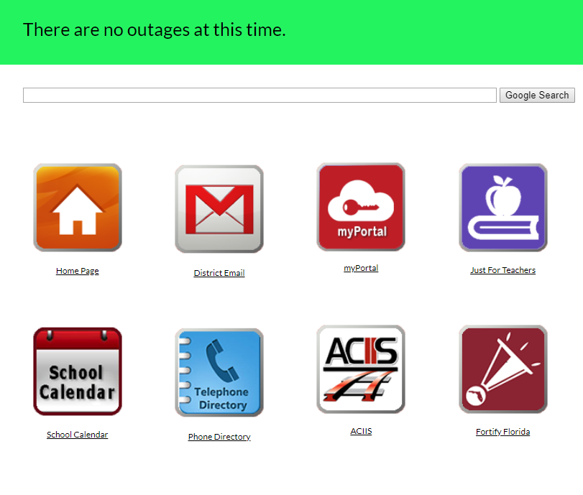
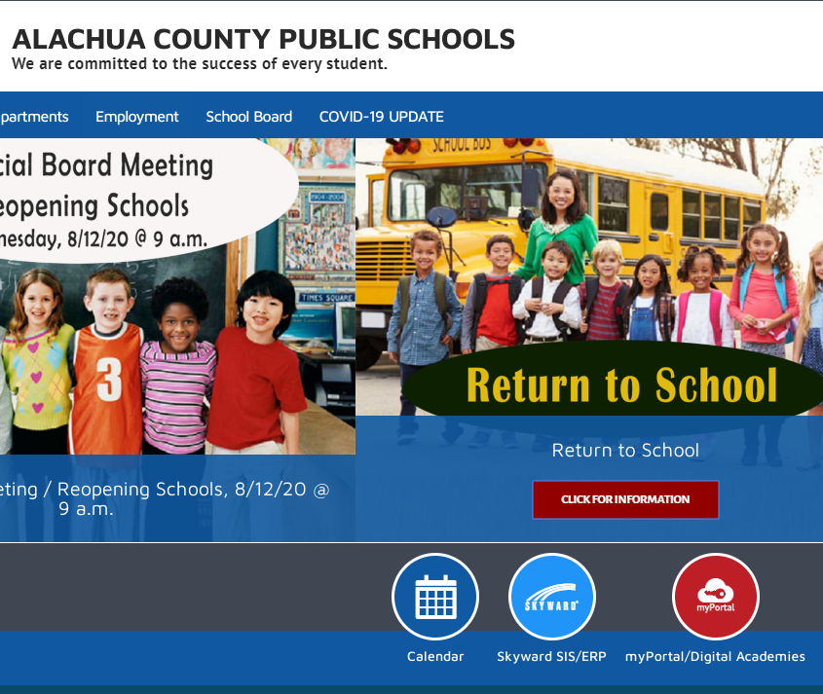
FINDING THE LINK TO ONLINE TEXTBOOKS
https://sites.google.com/gm.sbac.edu/launchpad/just4students OR... https://www.sbac.edu/

Slide 3
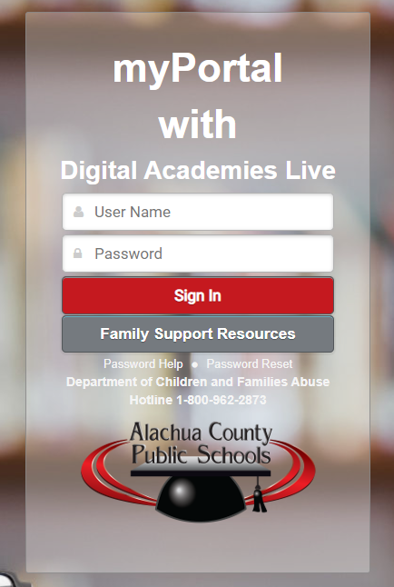
Student username and password
If your child cannot remember their username or password, visit
https://docs.google.com/document/d/1h2PgYSIF0ikt-kOKg2rwklBFgpR8paGCi5BSfqU8HGI/edit

Slide 4
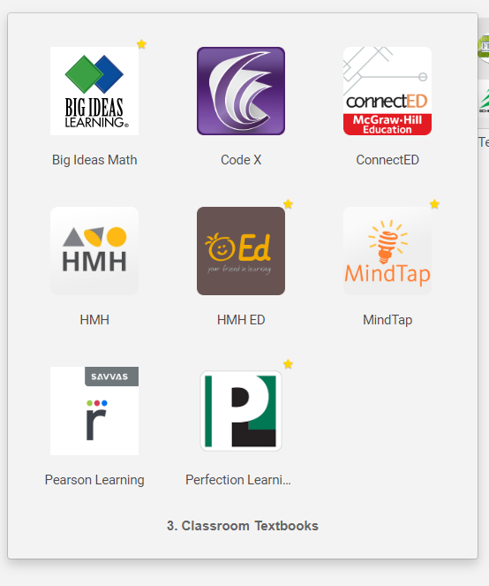
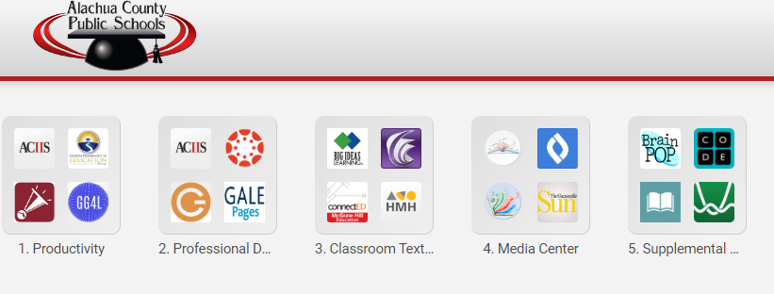
Finding textbooks within the student portal
Step 1 - click box for Classroom Textbooks
Step 2 -Select the textbook for your child’s class

Slide 5
How do I find out which publisher for my child’s text?
This information should have been given to your child by their teacher and may be on the teacher’s website.
If you still need help…
Contact your child’s teacher via email
Contact Kanapaha Middle School at 352-955-6960

