Slide 1
Why Learn French?

Slide 2
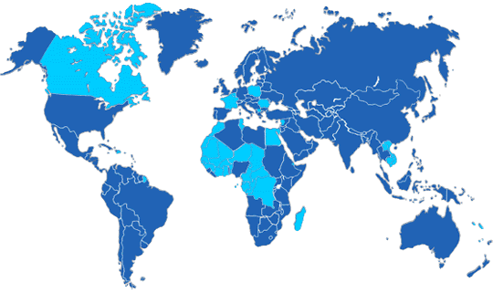
French is the official language of over 20 countries.

Slide 3
At Eastside, there are many opportunities to learn the French language and experience the culture of various francophone regions.

Slide 4
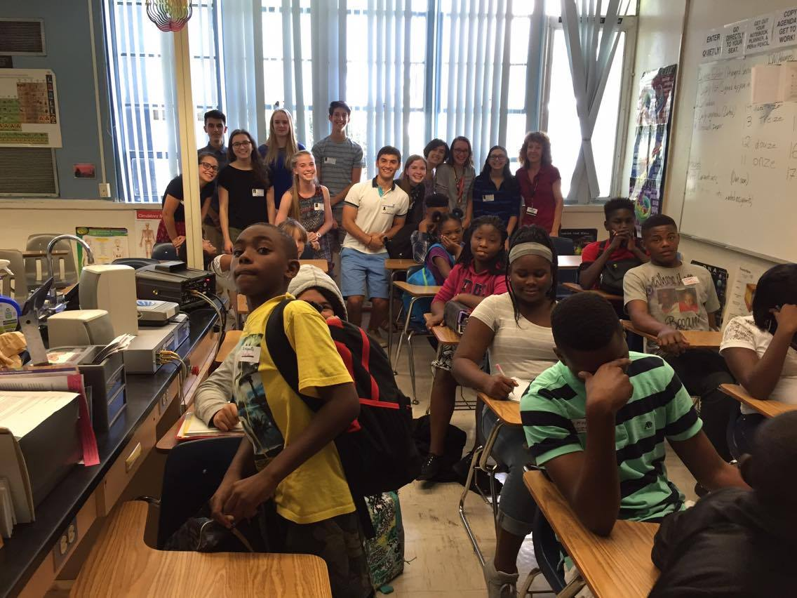
French Club has started community outreach program to get more people involved in learning the French language and culture.

Slide 5
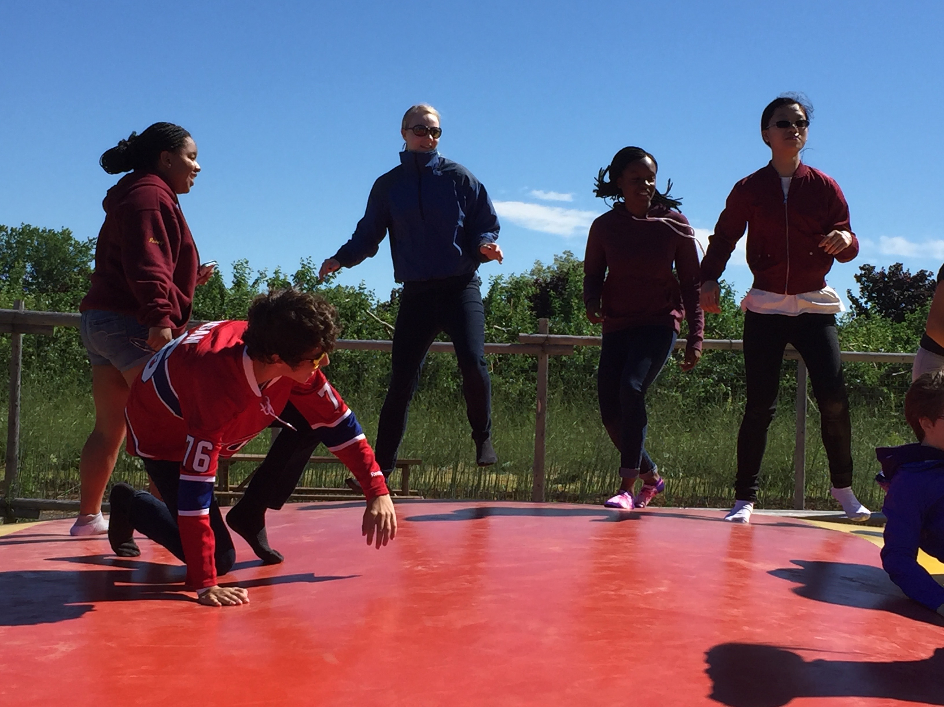

We also participate in opportunities to expand our knowledge of the French language. This past summer some students completed an immersion program in Quebec.

Slide 6
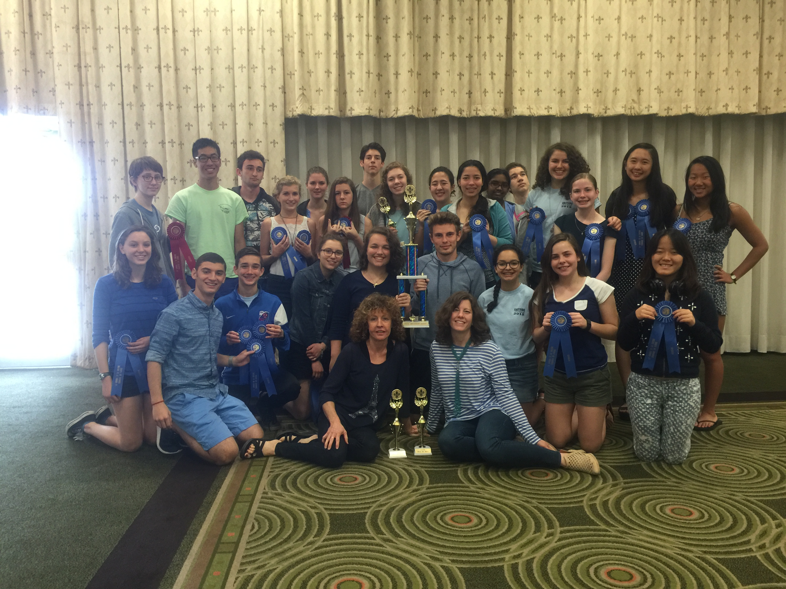
Every year we go to Congrès (the State French competition that involves tons of high schools in Florida) – and basically win every year!

Slide 7
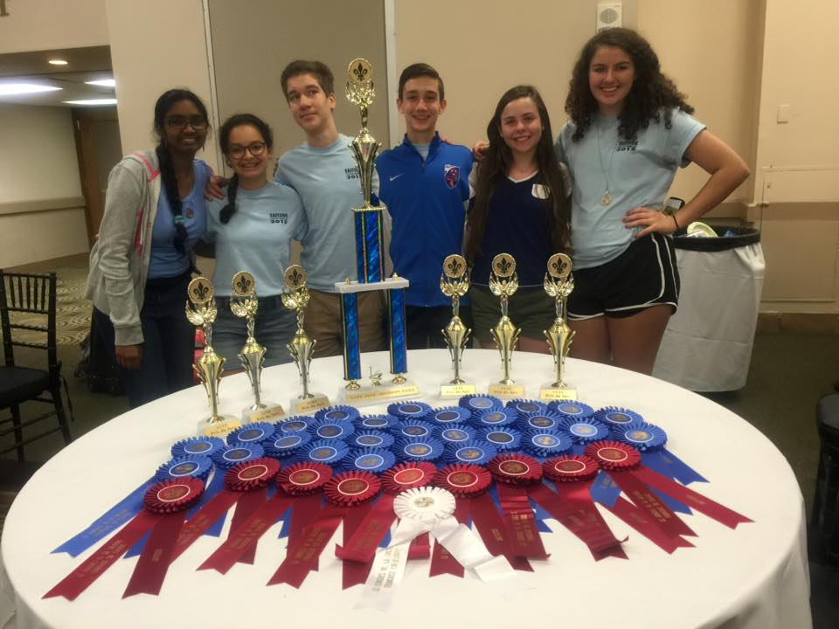
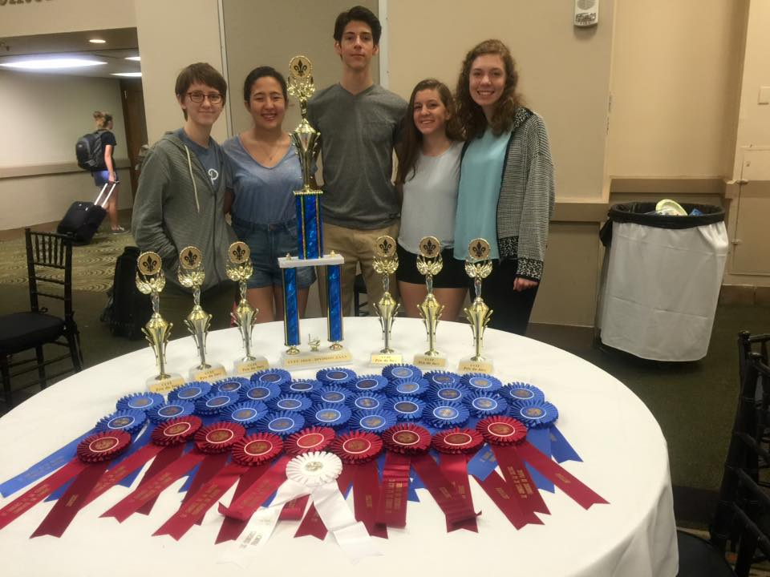
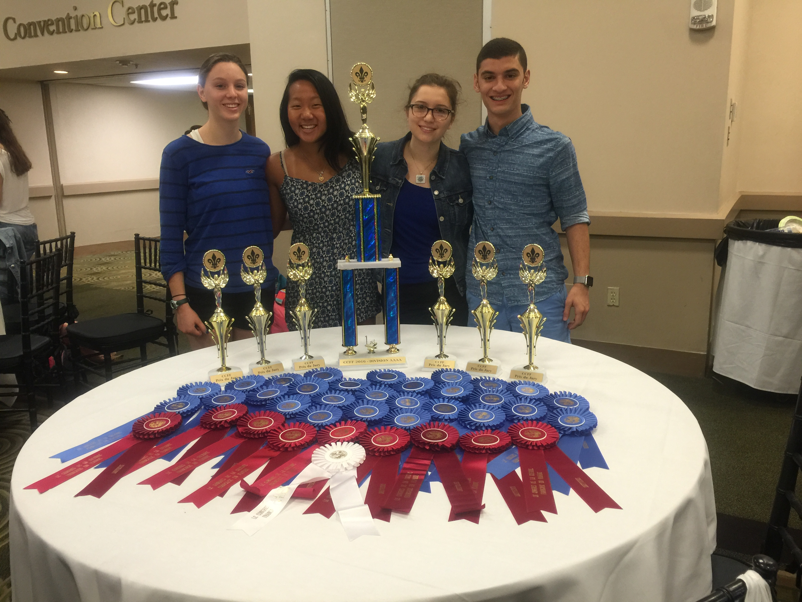
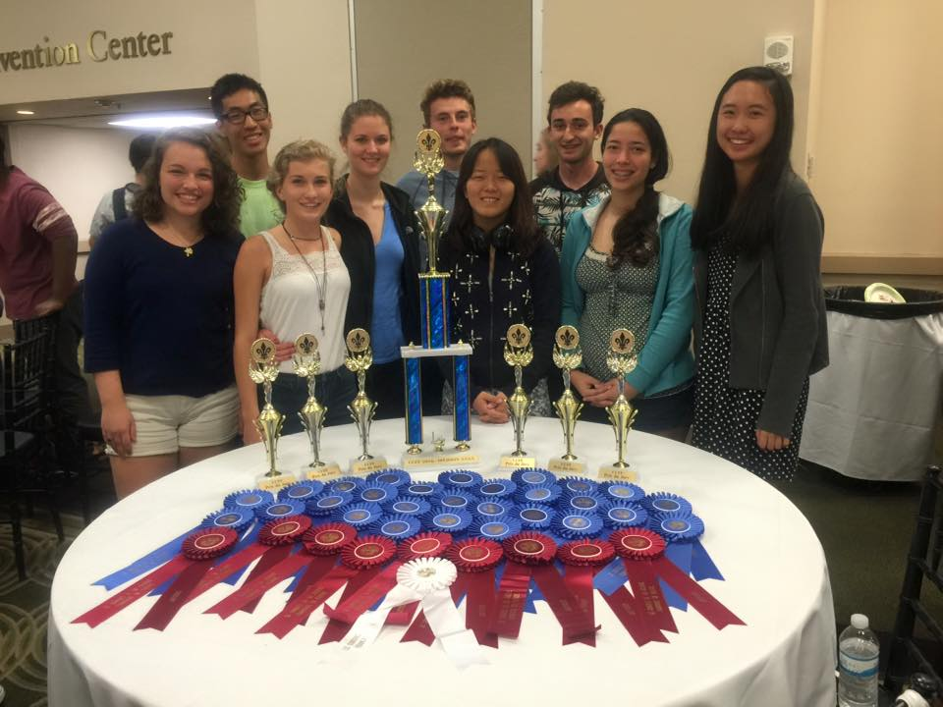

Slide 8
We don’t just learn the French language to the point of writing and speaking it at a high proficiency level! We learn about the culture in francophone countries through monthly Cultural Potlucks within and outside our school, where we make and food from that region.

