Slide 1
Updated 8-6-14
Alachua County Public Schools
Teacher Evaluation System
2014-2015
“An environment for learning, whether learning by students or by adults, does not occur spontaneously, it must be planned and honored in practice”
Charlotte Danielson from Teacher Evaluation

Slide 2
Alachua County Teacher Evaluation Process The results of analyzing over 100,000 student achievement scores led to the statistical conclusion that “the most important factor affecting student learning is the teacher.” (Marzano, Classroom Instruction That Works)

Slide 3
Alachua County Teacher Evaluation Process The Alachua County Instructional Improvement System (ACIIS) was developed in compliance with F.S.1006.281 All references to ACIIS refer to the individual modules that comprise the Alachua County Instructional Improvement System.

Slide 4
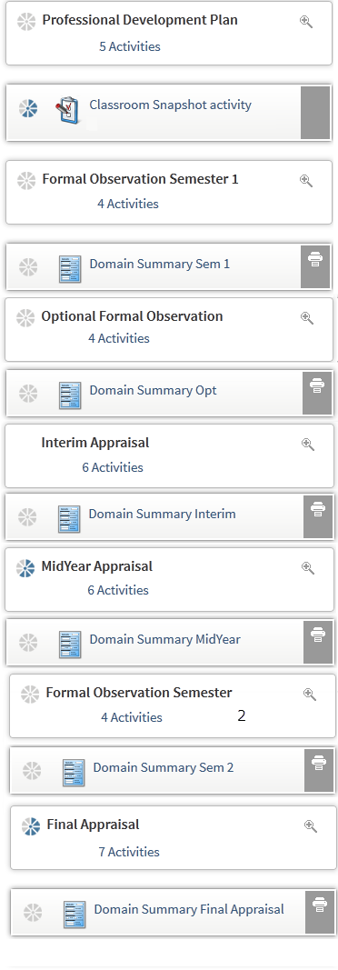
Alachua County Instructional Improvement System (ACIIS) Teacher Evaluation Module
NEW

Slide 5
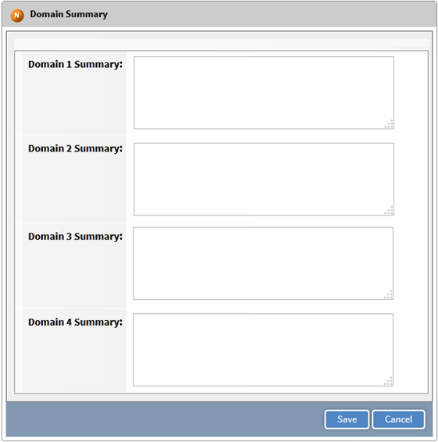
Alachua County Instructional Improvement System (ACIIS) Teacher Evaluation Module: Domain Summaries
There are domain summaries available for the Observations and appraisals.

Slide 6
Component I: Administrator Appraisal
Administrative Appraisal consists of the following:
Professional Development Plan (PDP)
Observations
Informal
Formal (two observations)
Administrator Feedback
Formal Administrator Appraisal
Annually for all teachers
Twice annually for newly hired teachers

Slide 7
Component I: Administrator Appraisal (continued)
The Professional Development Plan (PDP):
Must be aligned to the teacher’s most recent evaluation results.
Objectives, activities and outcomes must be specific and measurable.
Timeline: Online PDPs must be completed by Friday, September 26, 2014.
(or 30 school days from date of hiring)
Teacher Evaluation by Danielson and McGreal

Slide 8
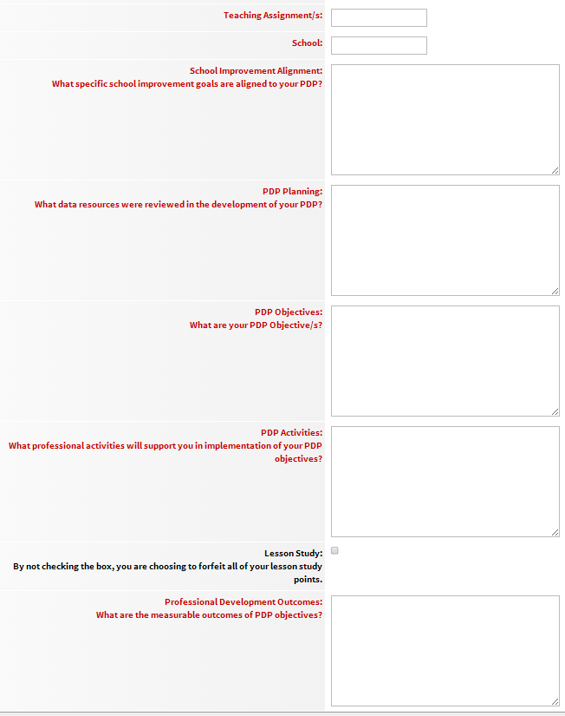
Component I: Administrator Appraisal (continued)
ACIIS Appraisal Module – Professional Development Plan
FCAT data will not be posted for the 2014-2015 School Year, since the state is transitioning to a new state assessment and set of standards.

Slide 9
Component I: Administrator Appraisal (continued)
Observation Feedback
Informal Classroom Observations
Informal observations are not formally scheduled observations and may occur throughout the school year.
Informal observations are a “snapshot” of classroom practices.
Feedback from the classroom snapshot will be shared with the teacher through the ACIIS Appraisal Module.

Slide 10
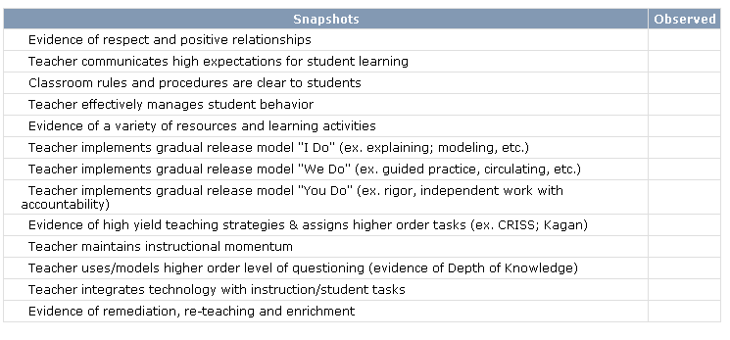
Component I:
Administrator Appraisal
Observation Feedback
ACIIS
Classroom Snapshot

Slide 11
Component I: Administrator Appraisal (continued)
Observation Feedback
Formal Classroom Observations – Protocols
Formal Observations will include an initial Online Planning Conference. The Online Planning Conference will occur 10 days prior to the first observation. The ACIIS Appraisal Module Initial Planning Conference process will be used. (An appointment may be scheduled with the administrator upon teacher request.)
If the teacher is not using the ACIIS Lesson Plan Module, the teacher will submit the lesson plan online to the appropriate administrator at least 5 days in advance of the scheduled formal observation.
Observation time in the classroom will follow the Collective Bargaining Agreement.

Slide 12
Component I: Administrator Appraisal (continued)
Observation Feedback
Formal Observation feedback will occur within 10 days of observation and includes written comments.
The ACIIS Appraisal Module Observation template will be used for observational feedback.
“Observation is a source of data for use in collecting evidence and for use as a focus for professional discussion and reflection on teaching and learning.”
Teacher Evaluation by Danielson and McGreal

Slide 13
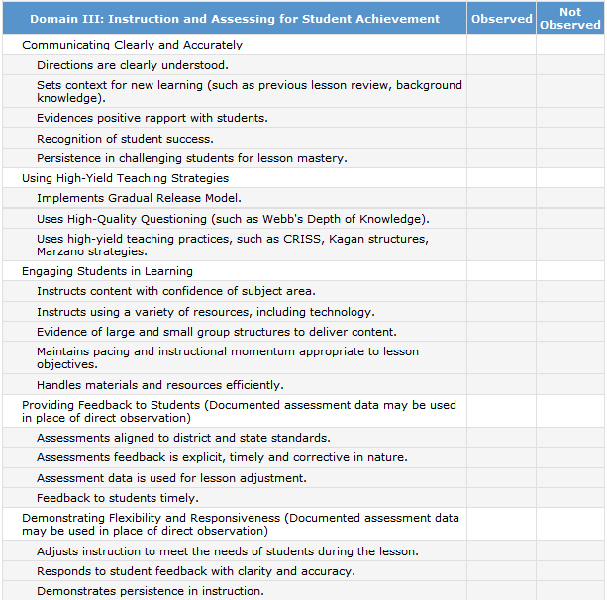
ACIIS
Formal
Classroom
Observations

Slide 14
Administrator Appraisal (Component I) Observation Feedback
Formal Observation Timeline:
Annual Contract Teachers -
Observation #1 by October 31, 2014
(or a minimum of 6 weeks from hiring date)
Observation #2 by March 31, 2015
PSC Teachers -
Observation #1 by January 15, 2015
Observation #2 prior to May 1, 2015
Teachers who received an overall Unsatisfactory on the 2013-2014 evaluation will follow alternate observation dates as listed in the Collective Bargaining Agreement.
Evaluator: Teachers will receive the name of their evaluator by the
third week of school.

Slide 15
Administrator Appraisal (Component I) Mid-Year Appraisals
A Mid-Year Appraisal will occur for all newly hired teachers. The Principal will appraise all newly hired teachers.
Mid-Year Appraisals for newly hired teachers will be scheduled by the administrator before the end of the first semester. (subject to change due to hiring date).
The Mid-Year Appraisal will use the ACIIS Appraisal Module Annual Appraisal Template for documentation.
An Appraisal Conference for any teacher may be scheduled anytime during the school year when appropriate.

Slide 16
Administrator Appraisal (Component I) Annual Formal Appraisal
Every teacher will receive an Annual Appraisal by the appropriate administrator.
The Annual Appraisal includes a scheduled conference by the appropriate administrator and utilizes the ACIIS Appraisal Module Annual Appraisal form.

Slide 17
Administrator Appraisal (Component I) Annual Appraisal Feedback
The Annual Appraisal is aligned to the ACPS performance rubric.
The ACPS appraisal performance rubric has five categories: Highly Effective, Effective, Developing, Needs Improvement, and Unsatisfactory.
The ACPS appraisal performance rubric is online for teacher access at the “Just 4 Teachers” link on the SBAC homepage.

Slide 18
Administrator Appraisal (Component I) Timeline
PSC teachers - Annual Appraisal completed by June 8, 2015.
Annual Contract teachers - Annual Appraisal completed by the last day of post-planning, June 8, 2015.

Slide 19
Component II Student Performance Model
Florida Statute Requirements
All teachers must have a “student data” performance score as a component of their evaluation.
The student performance score will be factored in at 40% of the teacher’s summative annual evaluation score when there are less than three years of available student data or 50% of the teacher’s summative annual evaluation score when there are three years of data available.

Slide 20
Student Data Component
Teachers who teach students taking the FSA:
VAM reading value for the teacher’s students.
If the teacher teaches math, VAM math value for the teacher’s students.
If the teacher teaches both reading and math, VAM reading and math for the teacher’s students will be used.
Teachers who do not teach students taking FCAT
K-3: Discovery Education Assessments will be used.
Grades 11 & 12: test results from AP, IB, AICE, PERT, ACT.
All courses not assessed by state or national assessments: District developed End-of-Course tests will be used.
Non-Instructional Teachers:
May include a combination of student learning growth data and/or other measurable student outcomes.
A separate orientation will occur in September to provide the DOE Technical Assistance information.
(see your school administrator for more information)

Slide 21
Teacher Evaluation Categories
The teacher’s summative score will determine the teacher category that is reported to the Department of Education.
High Performing
Effective
Needs Improvement (Developing in years 1-3)
Unsatisfactory

Slide 22
References
The Art and Science of Teaching by Robert Marzano
Better Learning Through Structured Teaching by
Douglas Fisher and Nancy Frey
Classroom Instruction That Works by Marzano, Pickering, and Pollock
Teacher Evaluation by Danielson and McGreal

Slide 23
Implementation Plan for Teacher Lesson Plans 2014-2015
The District will follow the same lesson plan procedures that were implemented last year.
All teachers are expected to have lesson plans.
Lesson plans/PCG are encouraged , but not required, to be done electronically. Principals can ask for lesson plans on a rotating basis by subject areas or grade levels.
If a teacher needs assistance in the area of planning or instruction, a principal can ask that the teacher turn in lesson plans more frequently than other teachers. The frequency would be dependent on the degree of assistance the teacher needs.
Three areas that are required in the lesson plans are as follows:
Benchmarks
Essential Questions/Objectives/ Higher Order Questions
Gradual Release

Slide 24
Alachua County Instructional Improvement System (ACIIS) Teacher Lesson Plan Module

