Slide 1
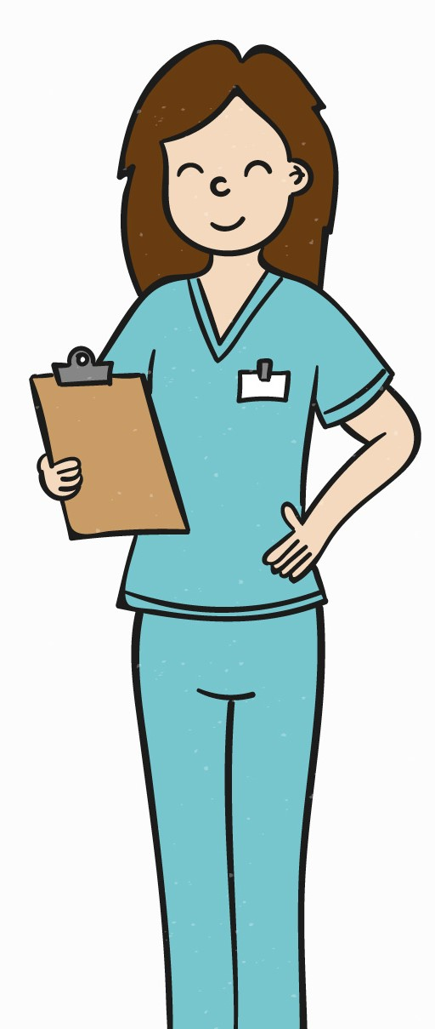
Let’s Learn about Heart Health

Slide 2
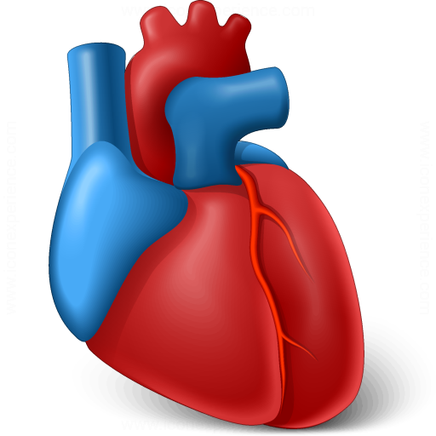
Our heart is one of the most important organs in our body. It is responsible for supplying the blood that we need to stay alive.

Slide 3
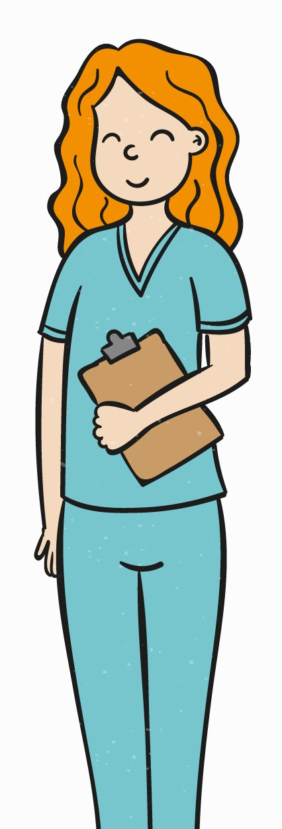
Why is it important to think about heart health now?
We only have one heart, and it is with us for the rest of our lives! Let’s look at ways we can keep it healthy early on.

Slide 4
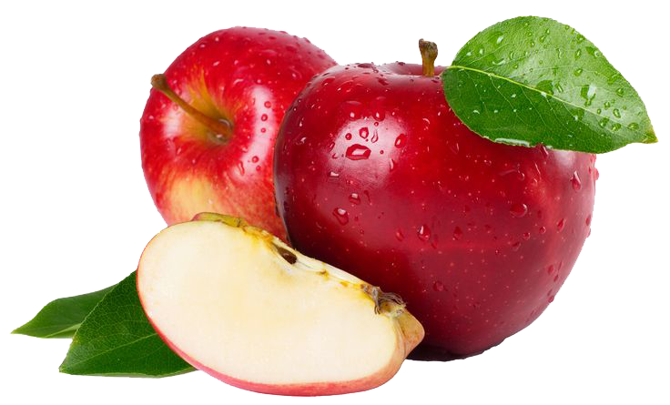
You can start taking care of your heart now by getting enough exercise each day and eating healthy foods.

Slide 5
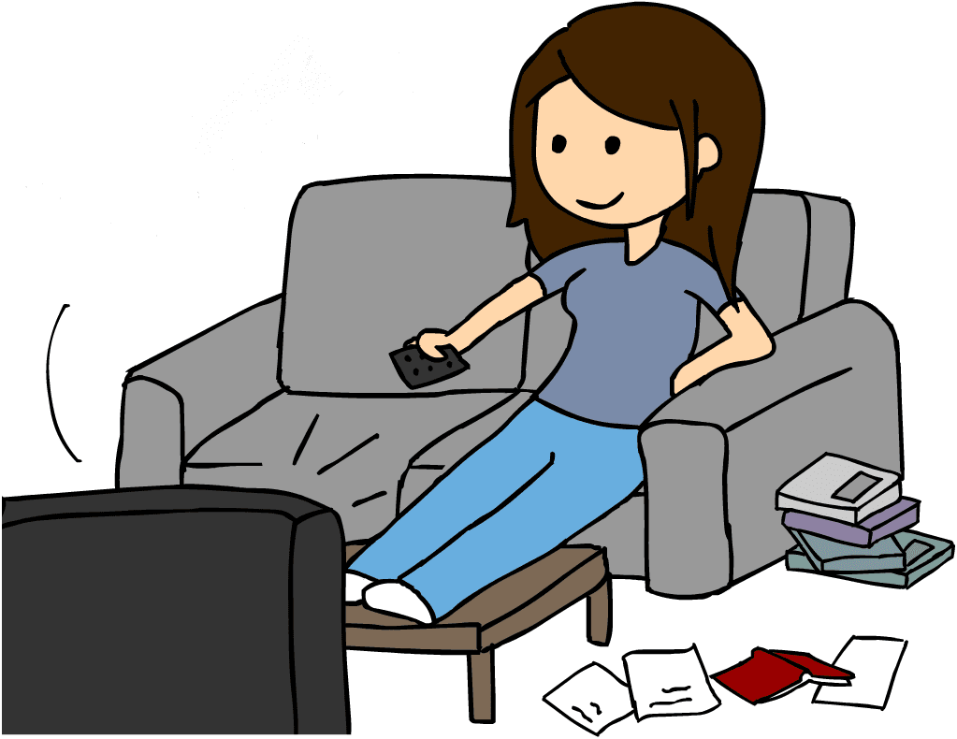
Here is a list of some activities. Click which one would be the most heart healthy!

Slide 6
Correct!
Next

Slide 7
Sorry!
Try Again

Slide 8
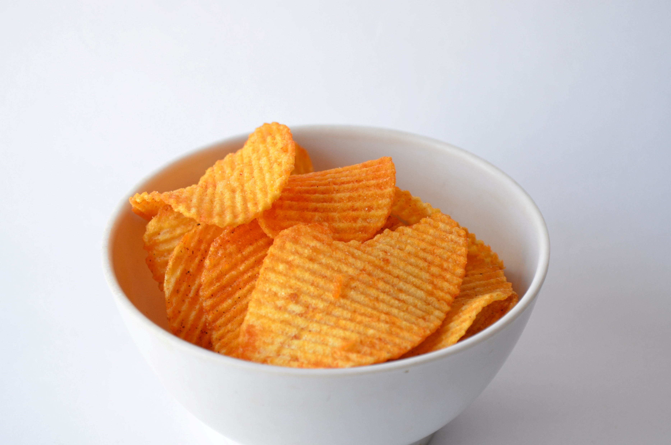
Here is a list of some snacks. Click which one would be the most heart healthy!

Slide 9
Correct!
Next

Slide 10
Sorry!
Try Again

Slide 11
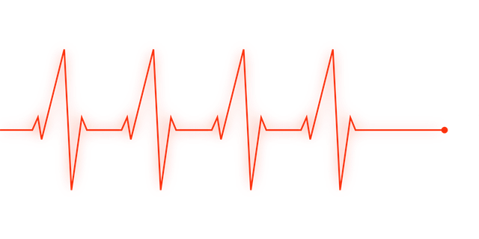
What happens if we are not being heart healthy?
It often takes many years of a very unhealthy lifestyle to cause our heart to become unhealthy. If this happens, we may develop heart disease and feel unwell.

Slide 12
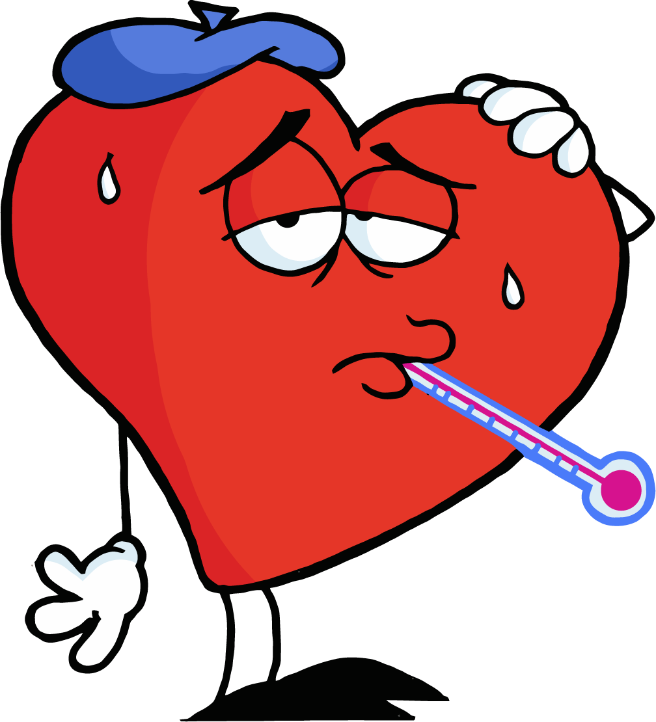
Does that mean our heart gets sick?
Our heart does not get sick, but it can become unhealthy as we get older and don’t take care of it.

Slide 13
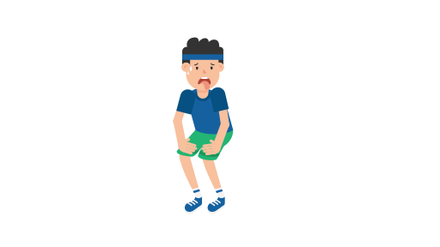
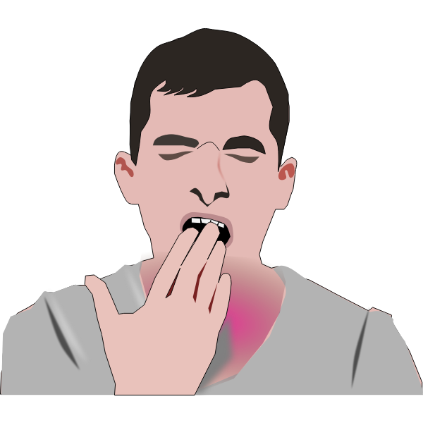
Some people with heart disease may
and
feel tired more easily
quickly run out of breath from activities

Slide 14
Those aren’t good!

Slide 15
I am getting a message from the doctor. She seems concerned about a patient.
Let’s speak to the her!

Slide 16
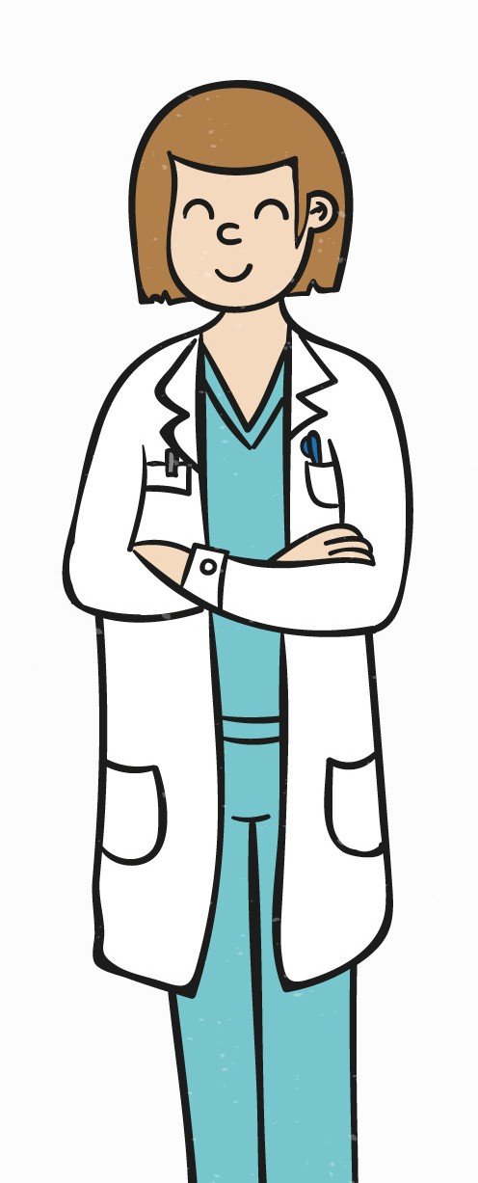
I have an older patient today who is getting tired very easily from activities that never used to tire her.
Send a message
This Photo by Unknown Author is licensed under CC BY-SA

Slide 17
I have an older patient today who is getting tired very easily from activities that never used to tire her.
That sounds concerning. Does she exercise? What does she eat?
Next
This Photo by Unknown Author is licensed under CC BY-SA

Slide 18
Could this patient be on the way to heart disease?
She does not exercise at all. She also never eats fruits or vegetables.
Yes
Hmmmm
No
This Photo by Unknown Author is licensed under CC BY-SA

Slide 19
The patient is showing signs of possibly developing heart disease!
What do you think?
Her signs show that she may be on the way to heart disease!
Next
This Photo by Unknown Author is licensed under CC BY-SA

Slide 20
I will tell the patient right away so we can start changing her lifestyle! Thank you for your help!
Next
This Photo by Unknown Author is licensed under CC BY-SA

Slide 21
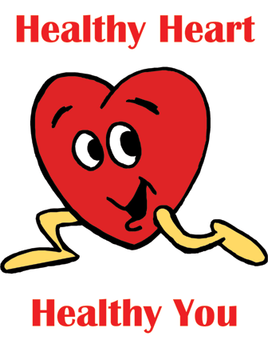
Great job helping out today! You all are now experts in staying heart healthy.

Slide 22
Picture Sources
<a href='https://www.freepik.com/vectors/hand'>Hand vector created by freepik - www.freepik.com</a>
IconExperience » V-Collection » Heart Organ Icon
Soccer Ball: This Photo by Unknown Author is licensed under CC BY-NC
Apple: This Photo by Unknown Author is licensed under CC BY-NC
Boy Playing Video Games: This Photo by Unknown Author is licensed under CC BY-SA-NC
Boy Jump Roping: This Photo by Unknown Author is licensed under CC BY-SA
Watching TV: This Photo by Unknown Author is licensed under CC BY-NC-ND
Gum Drops: This Photo by Unknown Author is licensed under CC BY-NC-ND
Sick Heart: This Photo by Unknown Author is licensed under CC BY-NC
Out of Breath Boy: This Photo by Unknown Author is licensed under CC BY-SA
Heart Clip Art: This Photo by Unknown Author is licensed under CC BY-SA
Exclamation Point: This Photo by Unknown Author is licensed under CC BY-NC
Cell Phone: This Photo by Unknown Author is licensed under CC BY-SA
Healthy Heart Healthy You: This Photo by Unknown Author is licensed under CC BY

Slide 23
Information Sources
Cardiovascular Disease (CVD) Information and Resources (breakthecvdtrend.com)
Heart disease - Symptoms and causes - Mayo Clinic

